Slide 1
MOBILE APPLICATION DEVELOPMENT DROPBOX CLIENT Presented by group 2
Nguyễn Huy Hùng BI10-071
Hoàng Hữu Huy BI10-077
Nguyễn Hoàng Nam BI10-123
Lý Anh Kiệt BI10-092
Lương Nguyễn Việt Sơn BI10-156

Slide 2

INTRODUCTION
What is Dropbox ?
Founded in 2007 by MIT students Drew Houston and Arash Ferdowsi
A file hosting service
Operated by the American company Dropbox, Inc., headquartered in San Francisco, California
Offers cloud storage, file synchronization, personal cloud, and client software

Slide 3
ARCHITECTURE

Slide 4


Application
Code: JAVA
API: Dropbox

Slide 5


Libraries
Official Dropbox Java SDK 2.1.2 API
Picasso

Slide 6
ACTIVITIES

Slide 7
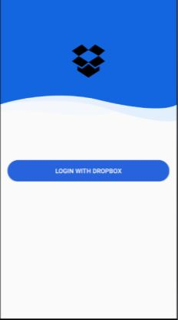
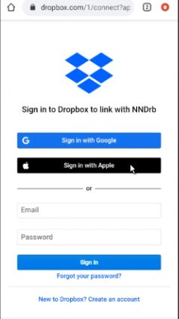
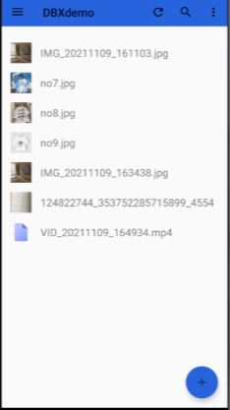
LOG IN SCREEN
Can use Google or Apple account

Slide 8
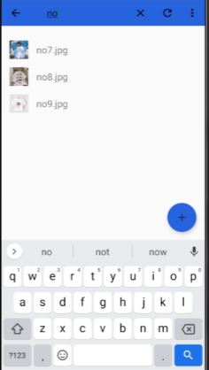
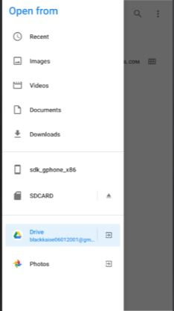
HOME SCREEN
Search
Add

Slide 9
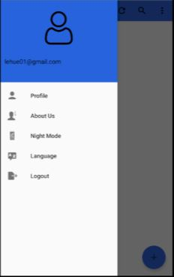
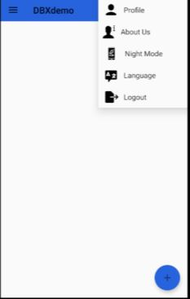
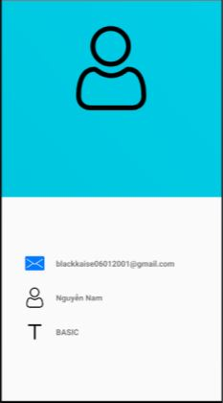
MENU
Toolbar
Profile

Slide 10
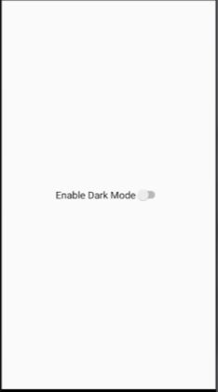
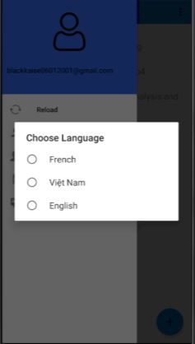
MENU
Night Mode
Language

Slide 11
NETWORKING
Connect to Dropbox
Uploading, downloading, searching, restoring images, videos
Get user’s account (Gmail, name, type)

Slide 12
DEMO

Slide 13
CONCLUSION
Achievements :
Using DBX platform
Login
Search
List
Language
Upload files
Synchronization
Things to improve:
Dark mode
Download files

